Slide 1

A Machine Learning Approach to Honeypot Detection
Introduction to Machine Learning
PRESENTED BY Cody Barr
12/03/2025

Slide 2
What is a Honeypot
Since its founding in 1831, NYU has been an innovator in higher education, reaching out to an emerging middle class, embracing an urban identity and professional focus, and promoting a global vision that informs its 19 schools and colleges.
Today, that trailblazing spirit makes NYU one of the most prominent and respected research universities in the world, featuring top-ranked academic programs and accepting fewer than one-in-five undergraduates.

Slide 3
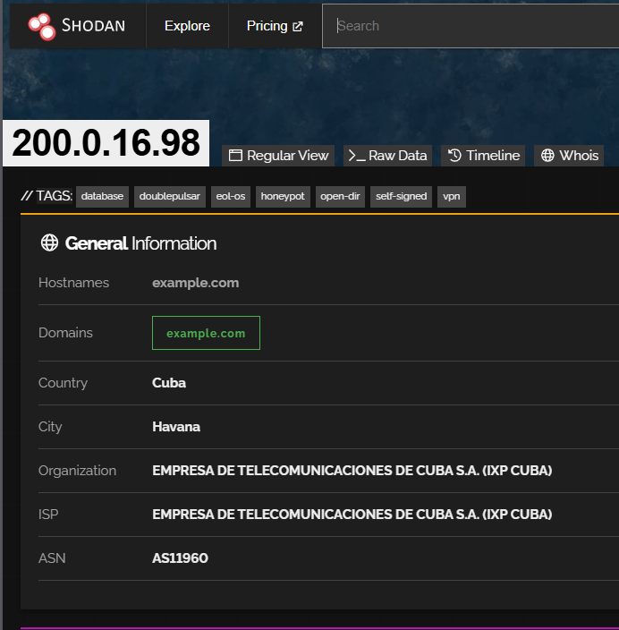
Gathering Data
Today, that trailblazing spirit makes NYU one of the most prominent and respected research universities in the world, featuring top-ranked academic programs and accepting fewer than one-in-five undergraduates.

Slide 4
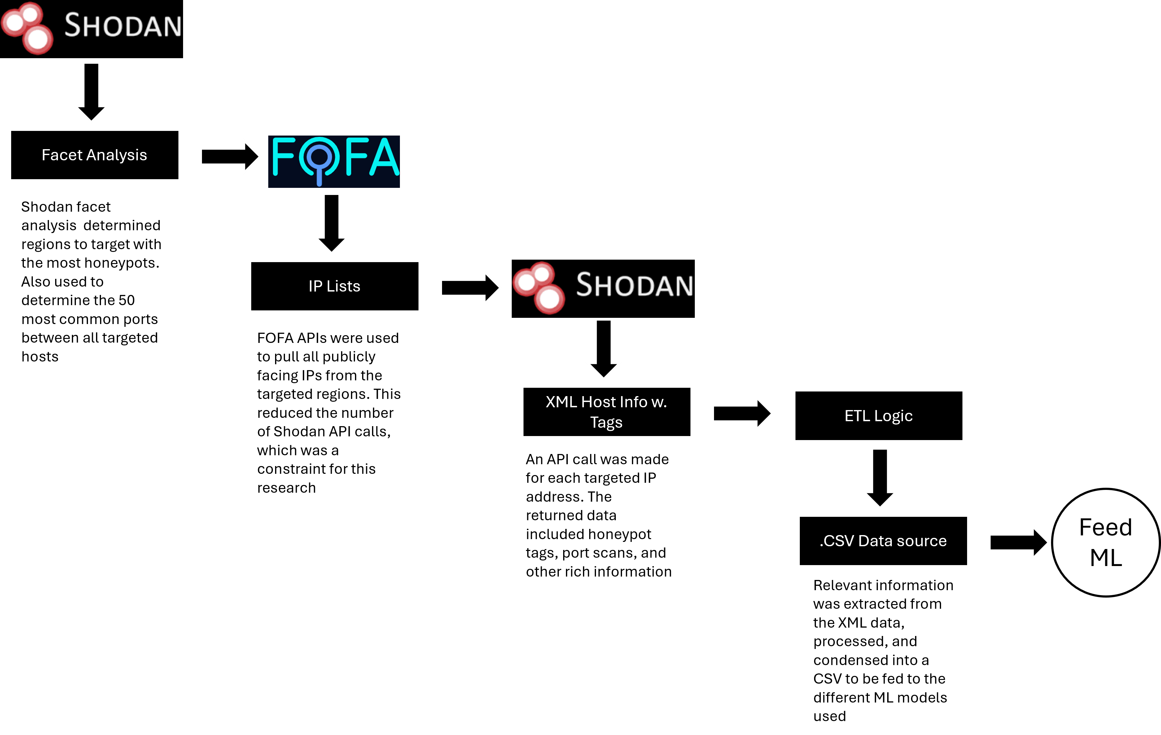
Gathering Data

Slide 5
>150GB
INCREASE SINCE 2010
Today, that trailblazing spirit makes NYU one of the most prominent and respected research universities in the world.

Slide 6
The Dataset
Ip | vulns | FTP-Data-20 | SSH-22 | Telnet-23 | Cassandra-9042 | Memcached-11211 | Zookeeper-2181 | well_known_ports | registered ports | isHoneypot
41.174.183.86 | 588 | 1 | 1 | 1 | 1 | 0 | 1 | 198 | 10 | 0
102.177.75.12 | 588 | 1 | 1 | 1 | 1 | 0 | 1 | 984 | 0 | 1
181.225.233.229 | 0 | 0 | 0 | 1 | 1 | 1 | 1 | 985 | 0 | 1
181.225.233.231 | 0 | 0 | 1 | 1 | 1 | 1 | 1 | 173 | 13 | 0
41.173.37.43 | 0 | 1 | 1 | 1 | 1 | 1 | 1 | 6 | 0 | 0
196.201.198.144 | 49 | 0 | 0 | 0 | 1 | 1 | 1 | 4 | 0 | 0
196.201.198.141 | 49 | 1 | 0 | 1 | 1 | 1 | 1 | 3 | 0 | 0
Vulnerability Counts
New York University has grown into one of the nation's leading institutions of higher ed
Top 50 Open Ports
New York University has grown into one of the nation's leading institutions of higher ed
Aggregated Port Counts
New York University has grown into one of the nation's leading institutions of higher ed
Class Label

Slide 7
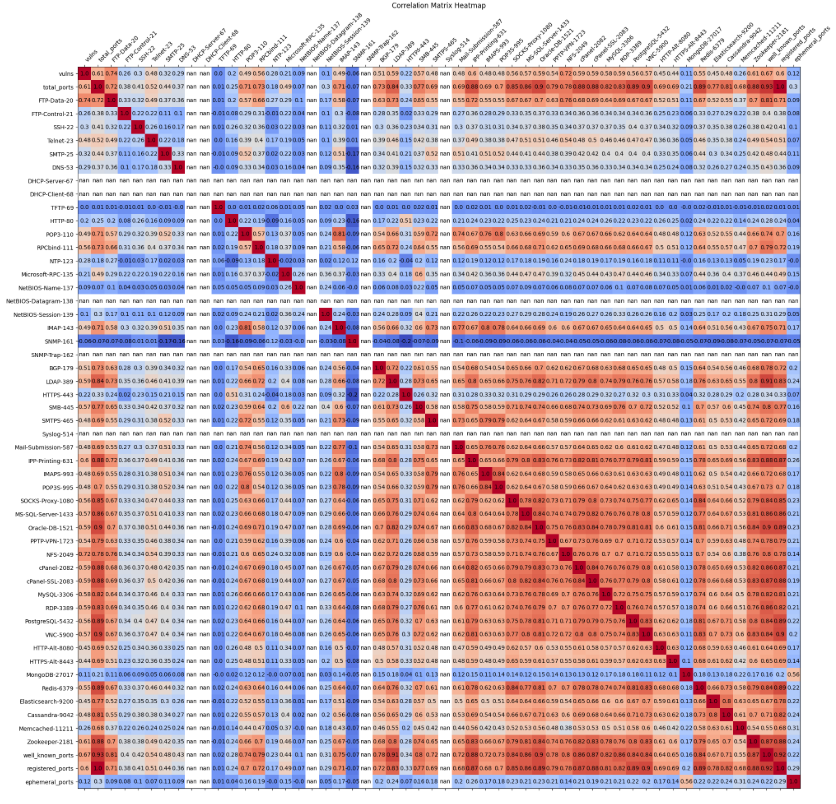
Gathering Data
Today, that trailblazing spirit makes NYU one of the most prominent and respected research universities in the world, featuring top-ranked academic programs and accepting fewer than one-in-five undergraduates.

Slide 8
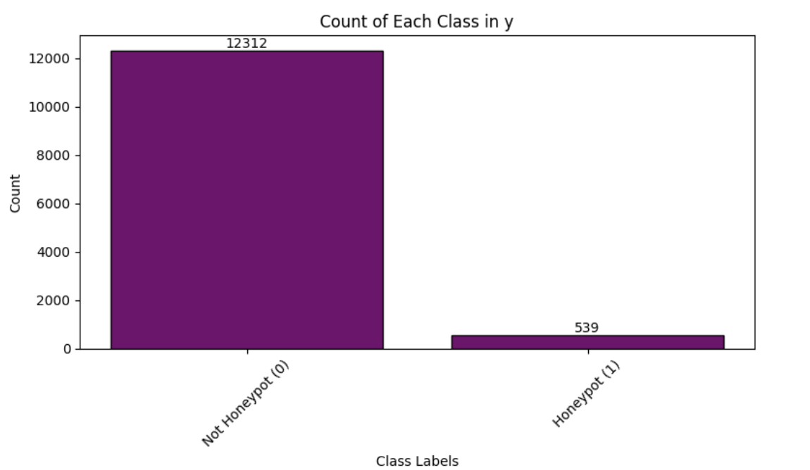
Gathering Data
Today, that trailblazing spirit makes NYU one of the most prominent and respected research universities in the world, featuring top-ranked academic programs and accepting fewer than one-in-five undergraduates.

Slide 9
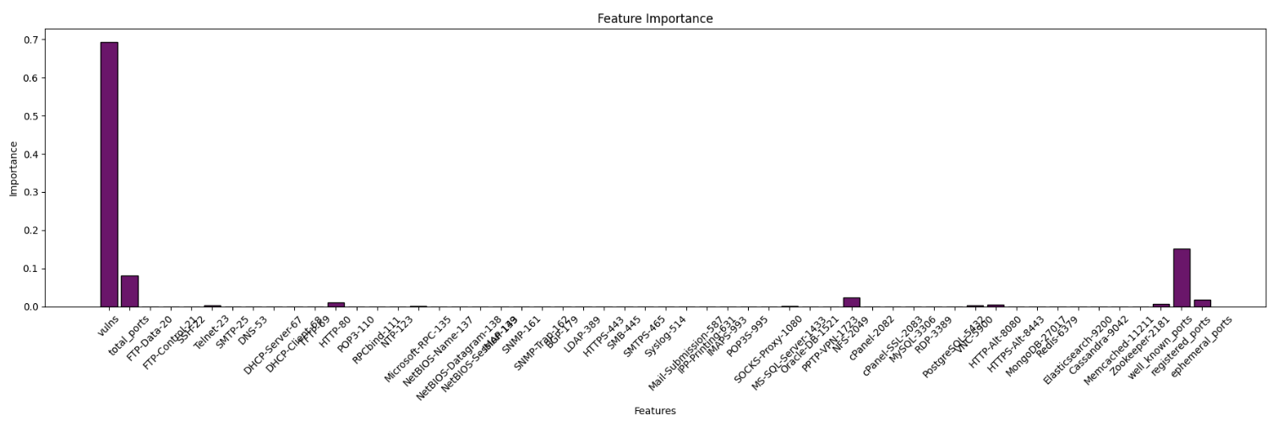
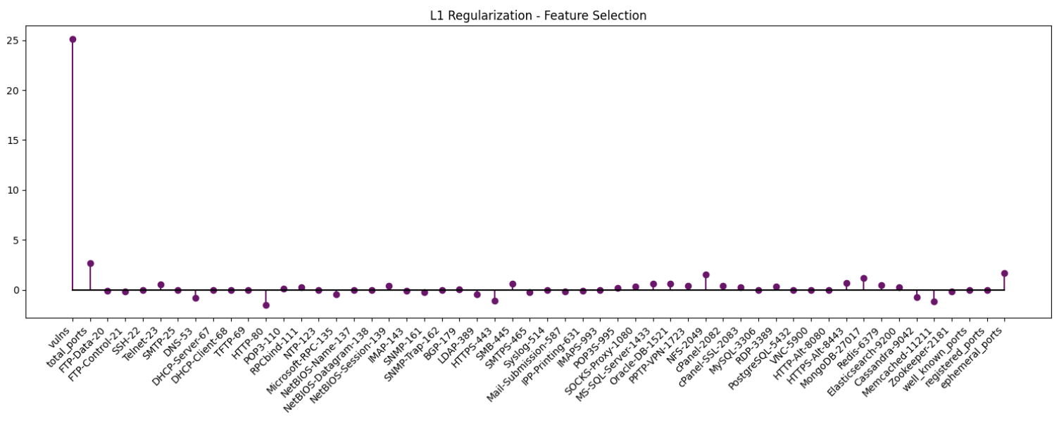
Vulnerability Count
Aggregated Totals
Individual Ports
CONFIRMATION

Slide 10
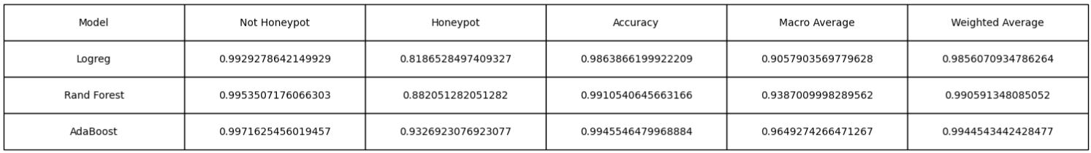
Model Performance
Logistic Regression
New York University has grown into one of the nation's leading institutions of higher ed
Random Forest
New York University has grown into one of the nation's leading institutions of higher ed
AdaBoost
New York University has grown into one of the nation's leading institutions of higher ed

Slide 11
Reducing Dimensionality
They are not feasible
Today, that trailblazing spirit makes NYU one of the most prominent and respected research universities in the world.

Slide 12
The Dataset v2
Ip | vulns | FTP-Data-20 | SSH-22 | Telnet-23 | Cassandra-9042 | Memcached-11211 | Zookeeper-2181 | well_known_ports | registered ports | isHoneypot
41.174.183.86 | 588 | 1 | 1 | 1 | 1 | 0 | 1 | 109 | 890 | 1
102.177.75.12 | 588 | 1 | 1 | 1 | 1 | 0 | 1 | 103 | 896 | 1
181.225.233.229 | 0 | 0 | 0 | 1 | 1 | 1 | 1 | 92 | 907 | 1
181.225.233.231 | 0 | 0 | 1 | 1 | 1 | 1 | 1 | 90 | 909 | 1
41.173.37.43 | 0 | 1 | 1 | 1 | 1 | 1 | 1 | 83 | 916 | 1
196.201.198.144 | 49 | 0 | 0 | 0 | 1 | 1 | 1 | 82 | 917 | 1
196.201.198.141 | 49 | 1 | 0 | 1 | 1 | 1 | 1 | 82 | 917 | 1
Vulnerability Counts
New York University has grown into one of the nation's leading institutions of higher ed
Top 50 Open Ports
New York University has grown into one of the nation's leading institutions of higher ed
Aggregated Port Counts
New York University has grown into one of the nation's leading institutions of higher ed
Class Label

Slide 13
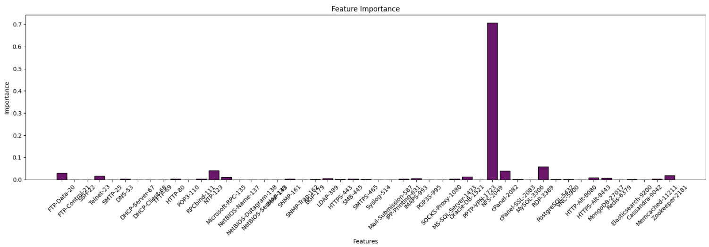
Reducing Dimensionality

Slide 14
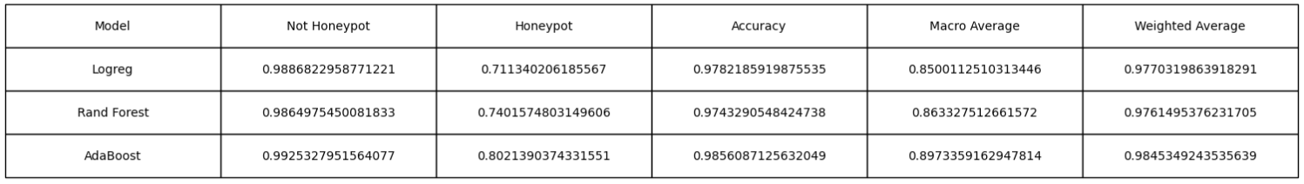
Model Performance

Slide 15
Anomaly Detection
They are not feasible
Today, that trailblazing spirit makes NYU one of the most prominent and respected research universities in the world.

Slide 16
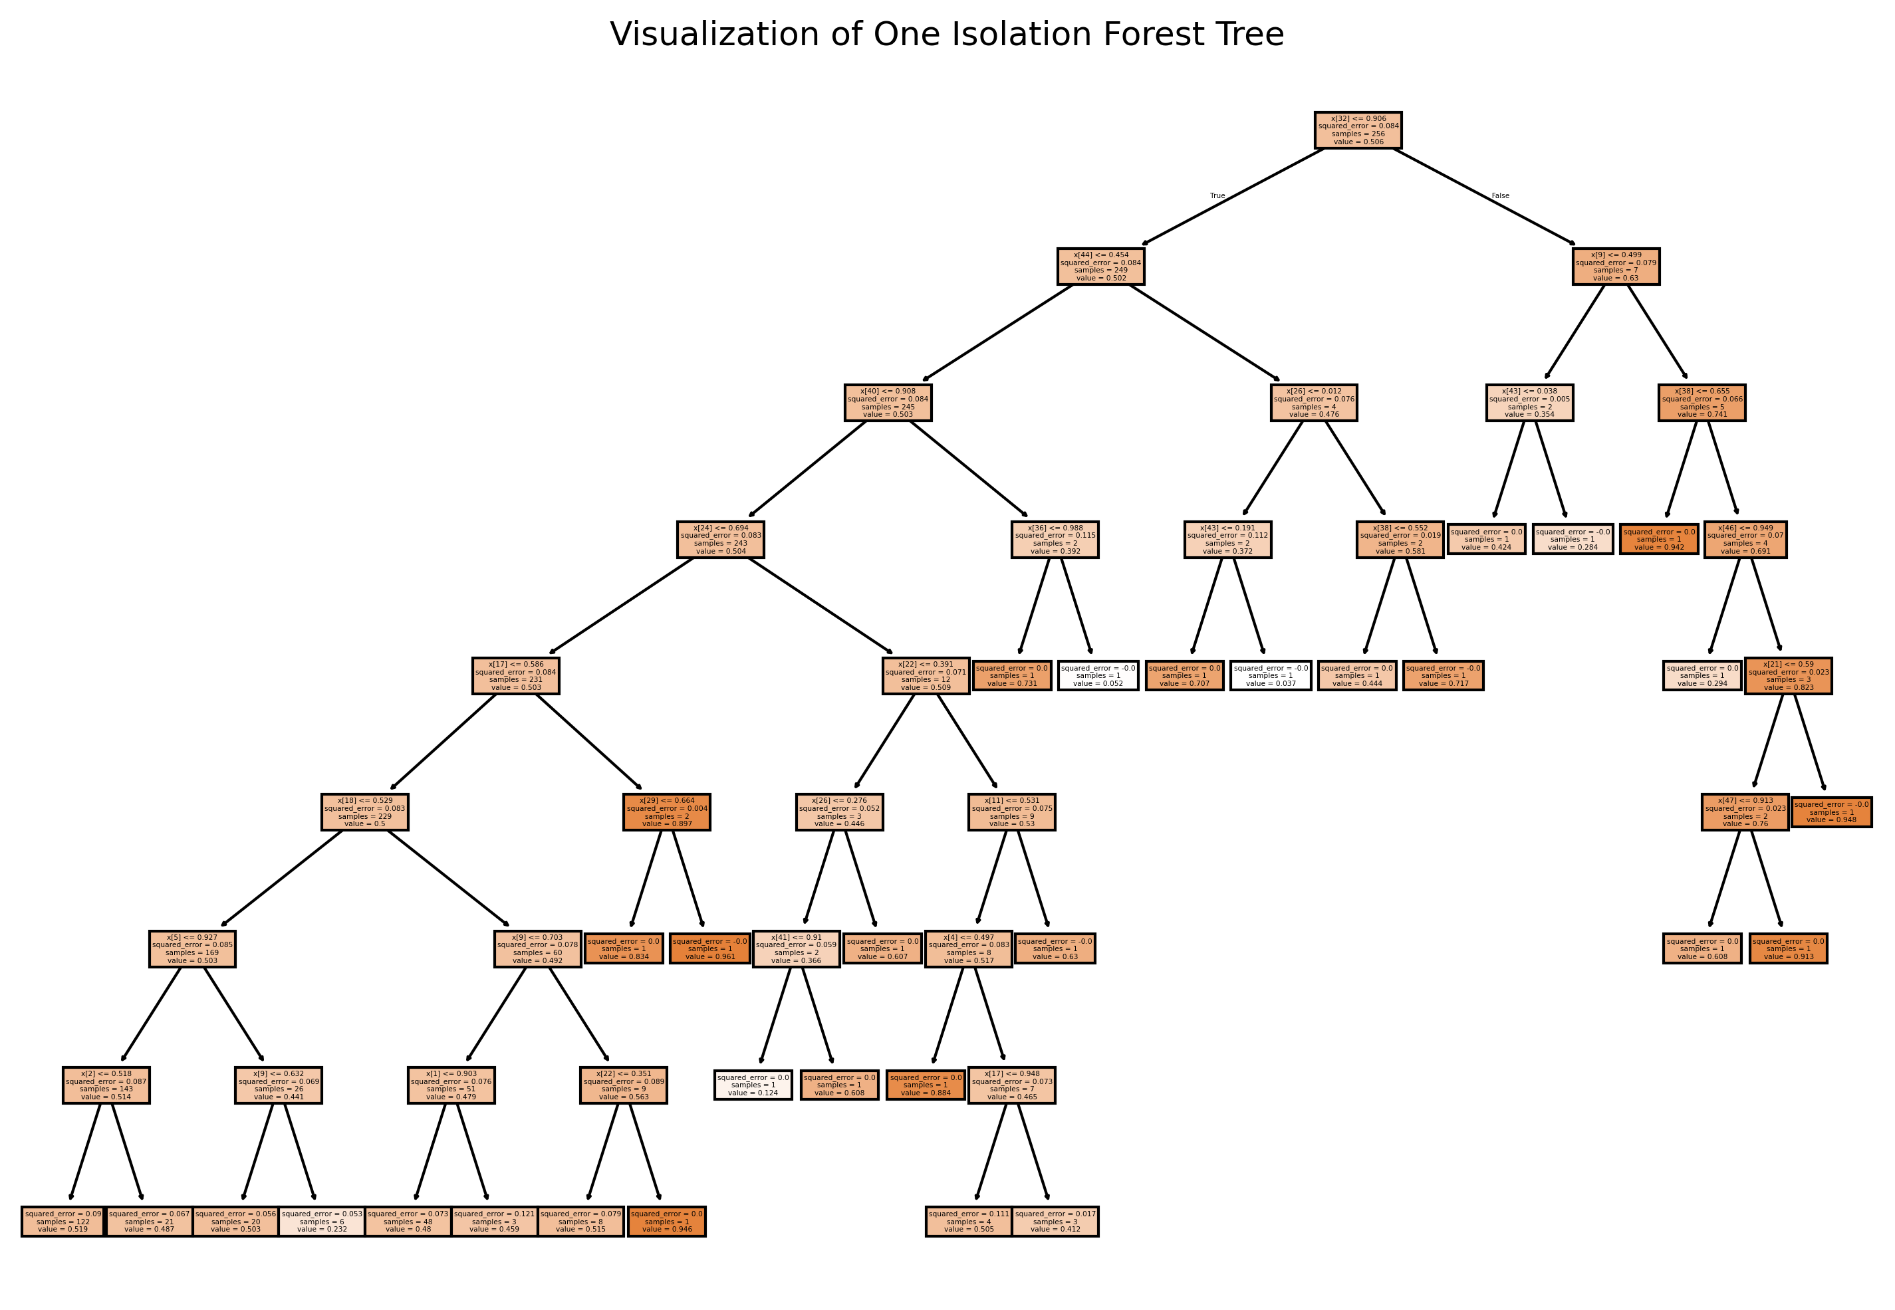
Gathering Data
Today, that trailblazing spirit makes NYU one of the most prominent and respected research universities in the world, featuring top-ranked academic programs and accepting fewer than one-in-five undergraduates.

Slide 17
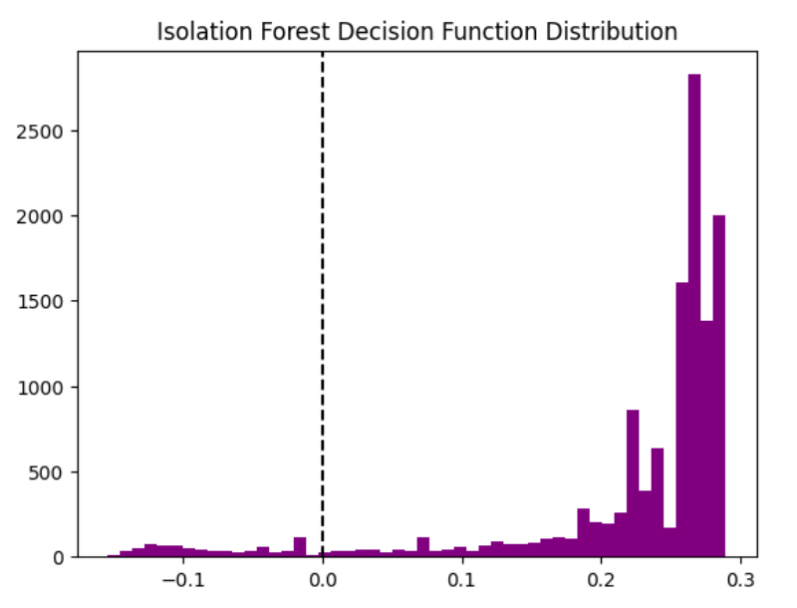
Gathering Data
Today, that trailblazing spirit makes NYU one of the most prominent and respected research universities in the world, featuring top-ranked academic programs and accepting fewer than one-in-five undergraduates.

Slide 18
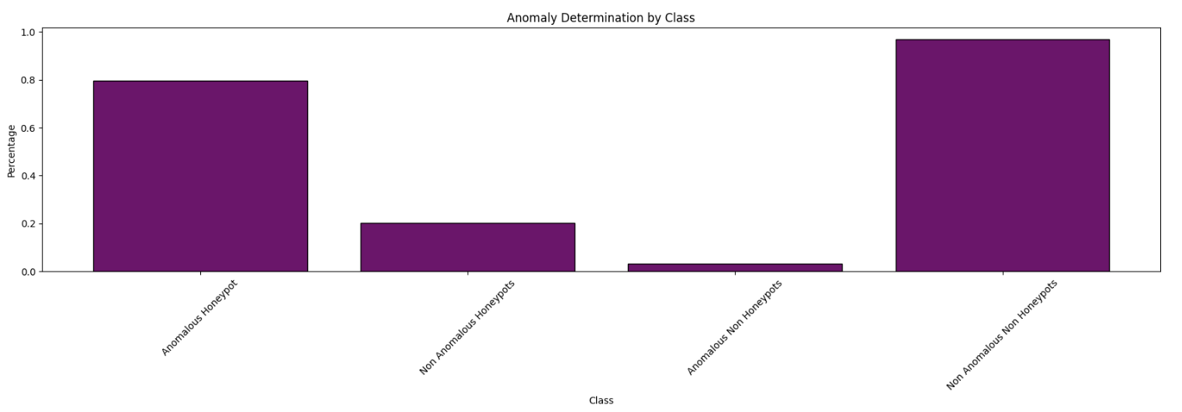
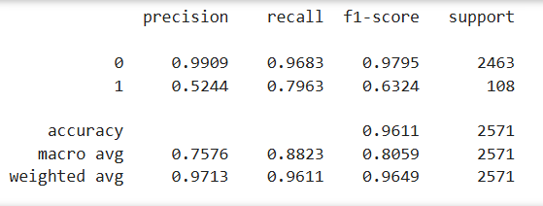
Gathering Data
Today, that trailblazing spirit makes NYU one of the most prominent and respected research universities in the world, featuring top-ranked academic programs and accepting fewer than one-in-five undergraduates.

Slide 19
Implementation
They are not feasible
Today, that trailblazing spirit makes NYU one of the most prominent and respected research universities in the world.

Slide 20
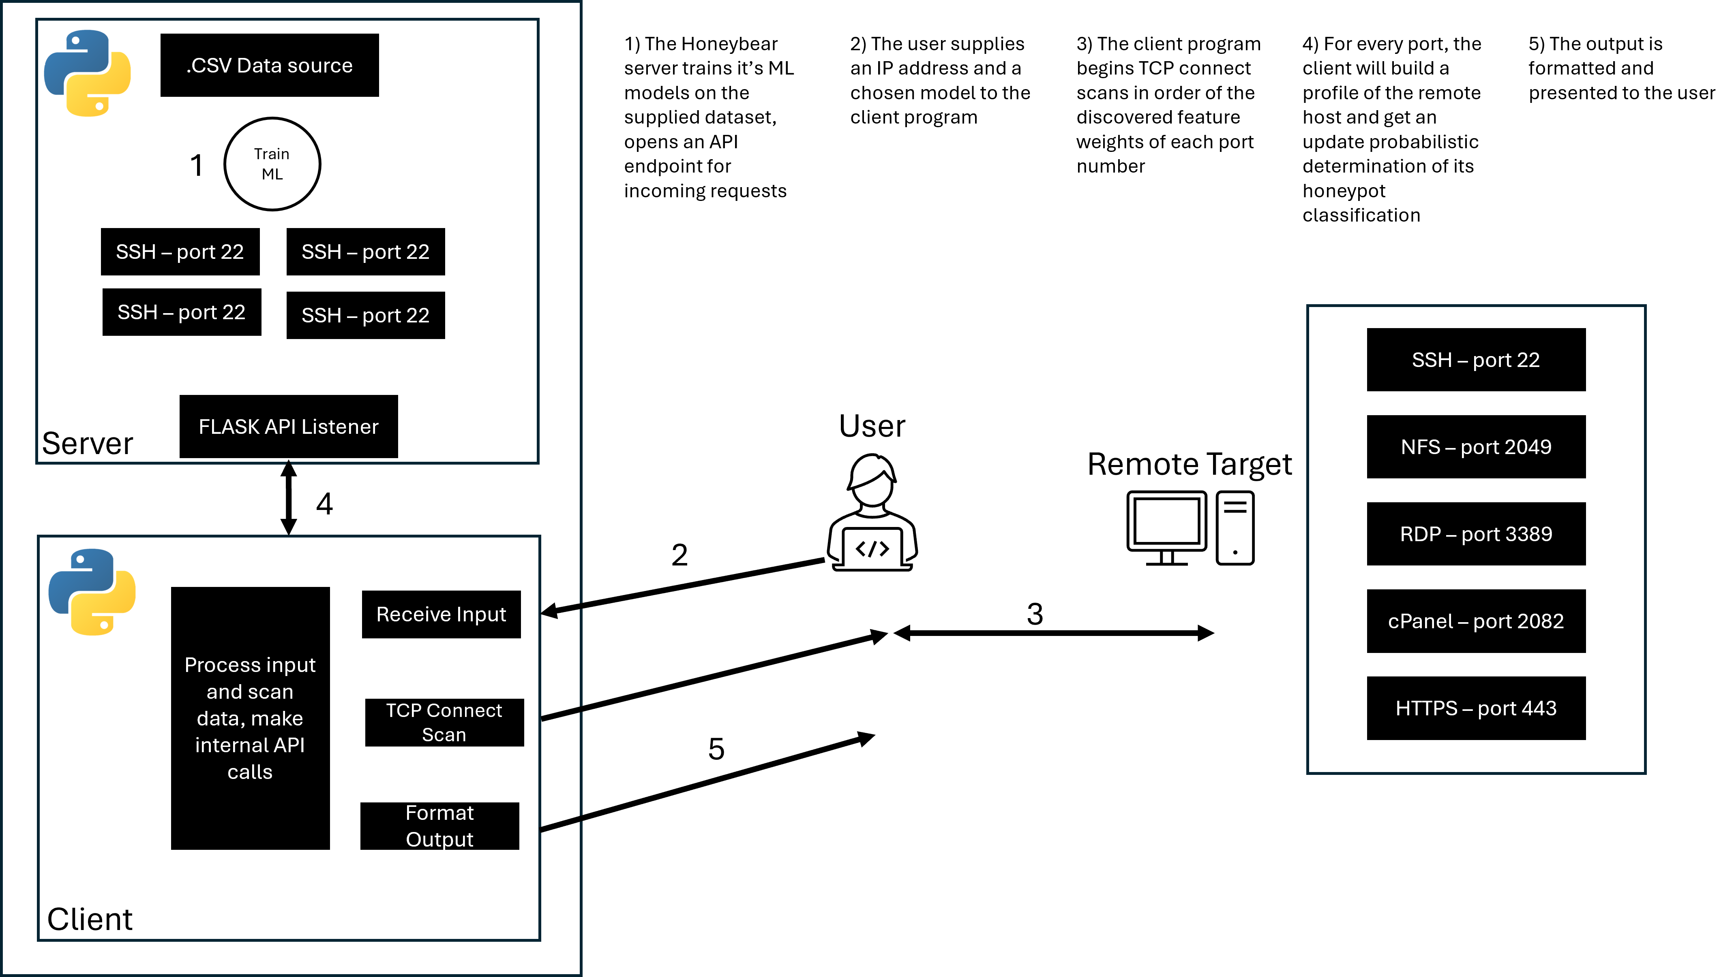
Gathering Data

Slide 21
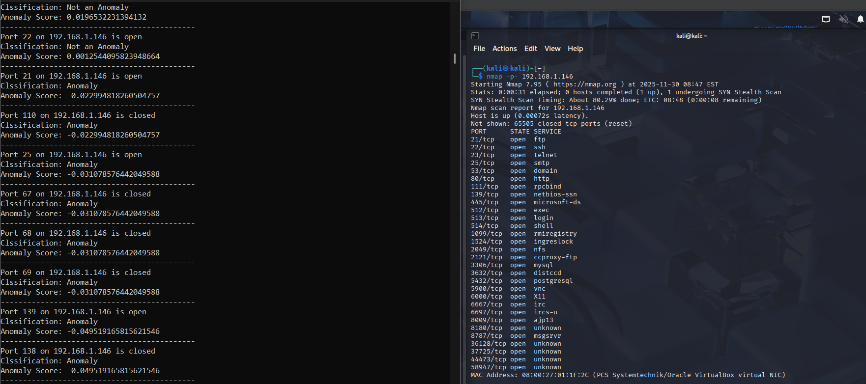

Slide 22


Slide 23
Conclusion
They are not feasible
Today, that trailblazing spirit makes NYU one of the most prominent and respected research universities in the world.

Slide 24
Related Works
They are not feasible
Today, that trailblazing spirit makes NYU one of the most prominent and respected research universities in the world.

Slide 25
Sources
They are not feasible
Today, that trailblazing spirit makes NYU one of the most prominent and respected research universities in the world.

Slide 26
TEMPLATE NOTES
This template is part of the NYU Templates collection. Look through our Usage Guidelines for help topics and quick tips on how to use this template.
Download the Grackle Slides add-on to automatically run accessibility checks on all aspects of your document and get advice on how to make things better.

